Slide 1
Rom 4:16
“Therefore it is of faith that it might be according to grace, so that the promise might be sure to all the seed, not only to those who are of the law, but also to those who are of the faith of Abraham, who is the father of us all.”

Slide 2
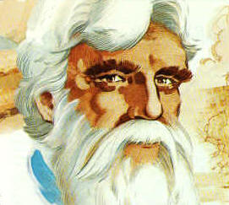
Abraham
A Great Example
Mentioned 70 times in the NT
His faith is used to teach us:
  Romans 4 - Example of salvation without works
  Hebrews 11 – Example of obedient faith
  James 2 – Example of faith & works

Slide 3
Bible Has Many Comparisons & Contrasts
Matt 12:41-42
41 The men of Nineveh will rise up in the judgment with this generation and condemn it, because they repented at the preaching of Jonah; and indeed a greater than Jonah is here.
42 The queen of the South will rise up in the judgment with this generation and condemn it, for she came from the ends of the earth to hear the wisdom of Solomon; and indeed a greater than Solomon is here.
You
Abraham

Slide 4
The Faith of
Abraham
How Does Our Faith Compare?

Slide 5
The Faith of
Abraham
I. Abraham’s Example
I. Abraham’s Example

Slide 6
I. Abraham’s Example
Feared God
  Gen. 22:12 – God gave testimony
  Understood what fear means:
- Willing to obey to the utmost
- Gen. 20:11 – how deal with others
- Gen. 20:11 – afraid to sin

Slide 7
I. Abraham’s Example
Feared God
Believed the promise
  Gen. 12:1-3 – believed & acted upon it
  Gen. 15:6 – believed in the Lord
  Believed against all reasoning (Rom. 4)
  Took God at his word

Slide 8
I. Abraham’s Example
Feared God
Believed the promise
Endured trials
  More to it than simply believing
  His faith was tested and tried

Slide 9
Trials of Abraham
Left home to go to an unknown place (12:1-5)
Occupy an occupied land (12:6)
Famine just as he entered the land (12:10)
Went to Egypt – wanted his wife (12:11-20)
Strife within family / God’s people (13)
Fight a war – caused by others (14)
Must send his own son away (21)
Asked to kill his son Isaac (22)

Slide 10
I. Abraham’s Example
Feared God
Believed the promise
Endured trials
Obeyed commands
  Told to go – went (Gen. 12:1-4; Heb. 11:8)
  Told to kill – tried (Gen. 22:10-12; Heb. 11:17)
  Told to be circumcised – was (Gen. 17)
  Without question, doubt, or excuse!

Slide 11
I. Abraham’s Example
Feared God
Believed the promise
Endured trials
Obeyed commands
Overcame his background
  Father (Terah) – in idolatry (Josh. 24:2)
  Pagan background – low and sinful
  Still became great example of faith

Slide 12
I. Abraham’s Example
Feared God
Believed the promise
Endured trials
Obeyed commands
Overcame his background
Strengthened his weakness

Slide 13
Abraham Had
Moments of Weakness
Thought might be
killed (12:12; 20:11)
Lied (12:13; 20:2)
Used Hagar (16)
Became Stronger
Strong enough that
he was willing to
sacrifice his own
son – at the command
of his God!
(Gen. 22)

Slide 14
The Faith of
Abraham
I. Abraham’s Example
II. How Do We Compare?
II. How Do We Compare?

Slide 15
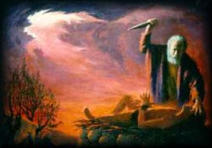
II. How Do We Compare?
Do you truly fear God?
  Stand in awe of his greatness (Jonah 1:9)?
  Afraid of doing wrong (Heb. 12:29)?
  Treat others right because afraid of judgment (Neh. 5:9; Gen. 20:11)?
  Willing to do anything / everything supposed to do (cf. Gen. 22:12)?

Slide 16
II. How Do We Compare?
Do you truly fear God?
Do you believe in what seems impossible?
  Believe in Lord’s return?
  Believe there will be a judgment?
  Believe whatever the Lord says?
  Believe God’s way is best? (raising children, home)
  Believe commands are for our good (Deut. 6:24)?

Slide 17
II. How Do We Compare?
Do you truly fear God?
Do you believe in what seems impossible?
Do you give up when things look tough?
  Ever want to just “quit”?
  Ever feel Lord asking “too much” of you?
  Do you require a lot of “pushing” or “nudging” to keep going?

Slide 18
II. How Do We Compare?
Do you truly fear God?
Do you believe in what seems impossible?
Do you give up when things look tough?
Do you get stronger or remain weak?
  Are you stronger than you were 5 years ago?
  Do you still do things that indicate weakness? (cf. 1 Cor. 13)

Slide 19
II. How Do We Compare?
Do you truly fear God?
Do you believe in what seems impossible?
Do you give up when things look tough?
Do you get stronger or remain weak?
Have you put your background in the past?
  Use your “past life in the world” – as a ticket to sin?
  Let the word of God change you?

Slide 20
II. How Do We Compare?
Do you truly fear God?
Do you believe in what seems impossible?
Do you give up when things look tough?
Do you get stronger or remain weak?
Have you put your background in the past?
Allow little things to interfere?

Slide 21
Can you Imagine Abraham Saying:
“Can’t leave Ur because this is my family”
“We are too old to see to a baby..”
“Can’t go offer Isaac, because I don’t feel good”
“I wasn’t circumcised, because I just haven’t had time”
“I won’t be able to rescue Lot because I’ve got a job”

Slide 22
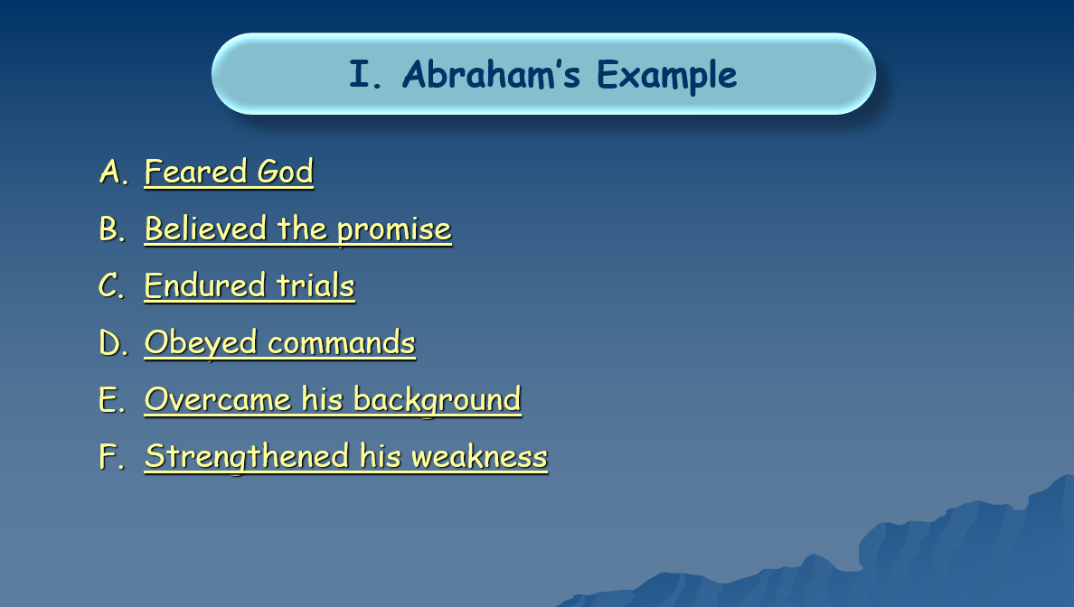
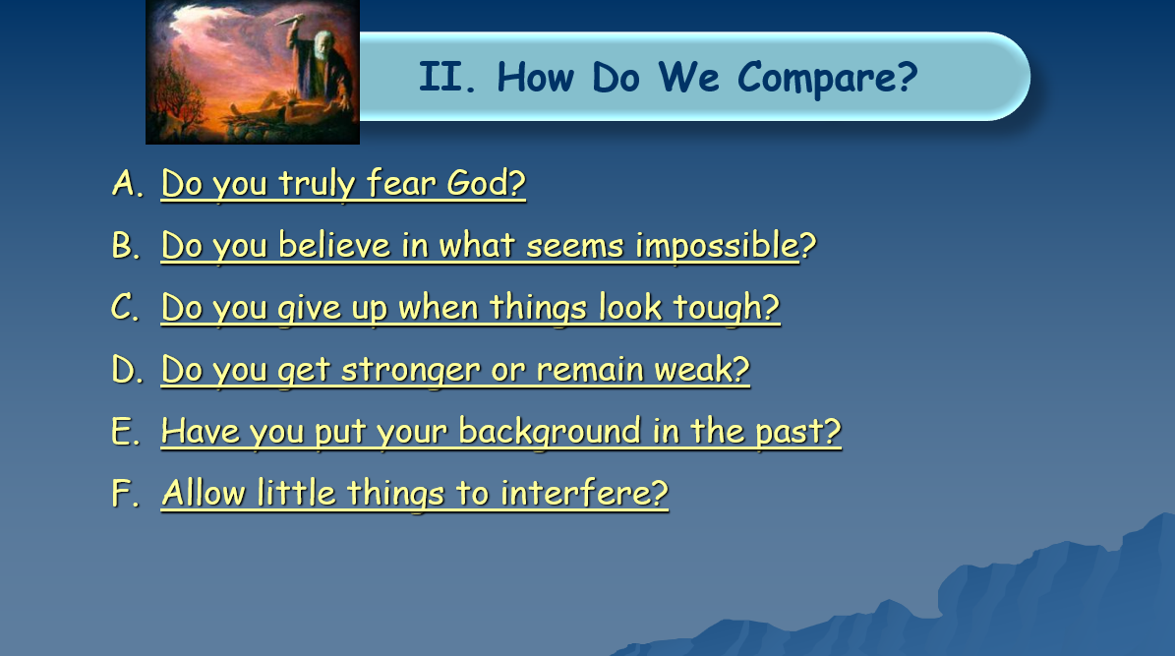
?

Slide 23
The Faith of
Abraham
I. Abraham’s Example
II. How Do We Compare?

