Slide 1
How would you rate / measure yourself spiritually?
?
Strong? (even “very strong”?)
Weak? (even “very weak”?)
Stronger than I was & getting stronger?
Weaker than I was & getting weaker?

Slide 2
Spiritual Weakness
?
1 Thessalonians 5:14
¹⁴ Now we exhort you, brethren, warn those who are unruly, comfort the fainthearted, uphold the weak, be patient with all.
Not the same as the unfaithful (unruly)
Not the same as the discouraged (fainthearted)
Not the same as one could be stronger in future

Slide 3
Need to Examine Self
?
2 Corinthians 13:5
⁵ Examine yourselves as to whether you are in the faith. Test yourselves. Do you not know yourselves, that Jesus Christ is in you?—unless indeed you are disqualified.
Need to ask:
Could I be getting weaker?
If so, why?

Slide 4
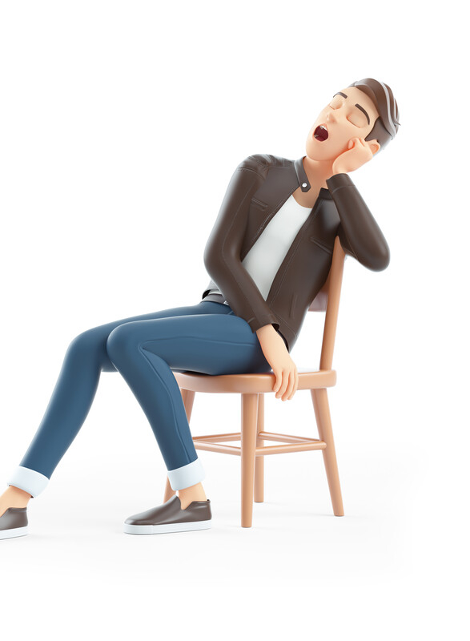
Am I Getting Weaker?
If so, Why?

Slide 5

Am I Getting Weaker?
If so, Why?
Goal: Be Strong and Growing
Goal: Be Strong and Growing

Slide 6
Goal: Be Strong and Growing
Should be growing stronger
  Kind of faith we should desire
    Strong faith (Rom. 4:19-20)
    Great faith (Matt. 8:10)
    Faith that doesn’t fail (Luke 22:32)

Slide 7
Goal: Be Strong and Growing
Should be growing stronger
  Kind of faith we should desire
  Maturing – growing stronger
    Faith should grow (2 Thess. 1:3)
    Faith should increase (Luke 17:5)
    Growing in knowledge & grace (2 Pet. 3:18)
    Developing faith – capable of doing more (Heb. 5:11-14)
    Increasing more and more (1 Thess. 4:10)

Slide 8
Goal: Be Strong and Growing
Should be growing stronger
How do I grow stronger?
  Feasting on the word
    Word is the source of growth (Acts 20:32; 1 Cor. 14:1-5)
    Should crave and thirst (1 Pet. 2:1-2; Psa. 119:16, 72, 127)
    Consistent study (Acts 17:11; Psa. 1:1-3; 1 Tim. 4:13)
    Will increase in:
      Knowledge (2 Pet. 3:18)
      Wisdom (2 Tim. 3:15)
      Purity (Psa. 119:11)

Slide 9
Goal: Be Strong and Growing
Should be growing stronger
How do I grow stronger?
  Feasting on the word
  Praying fervently
    Regular time (Psa. 55:16-17; Dan. 6:10)
    Make and schedule time (Mark 1:35; Luke 6:12)
    Powerful (Jas 5:16)
    Connected with faith (Luke 18:1, 8)

Slide 10
Goal: Be Strong and Growing
Should be growing stronger
How do I grow stronger?
  Feasting on the word
  Praying fervently
  Worship faithfully
    Not a spectator event – come to watch (if miss, no big deal)
    Must participate (Eph. 5:19; 1 Cor. 14:16)
    Edified / made stronger by worship (Eph 5:19; 1 Cor. 14:1-5)

Slide 11
Goal: Be Strong and Growing
Should be growing stronger
How do I grow stronger?
  Feasting on the word
  Praying fervently
  Worship faithfully
  Use the faith you have – make it active
    Exercise (1 Tim. 4:7; Heb. 5:14)
    Practice what you know (Jas. 1:22; Luke 17:6)

Slide 12
Am I Getting Weaker?
If so, Why?
Goal: Be Strong and Growing
Possible to Get Weaker
Possible to Get Weaker

Slide 13
Possible to Get Weaker
Could go backwards -spiritually
  Possible to no longer run well (Gal. 5:7)
  Fire could go out (Rev. 2:4-5)
  Could become lukewarm (Rev. 3:15-16)
  Faith could fail (Luke 22:32)
  Faith could become weak (Rom. 4:19)

Slide 14
Possible to Get Weaker
Could go backwards –spiritually
Happens slow and gradual
  We drift – spiritually leaks (Heb. 2:1-2)
  Makes it hard to recognize
  Hardly anyone just quits – happens over time

Slide 15
Possible to Get Weaker
Could go backwards –spiritually
Happens slow and gradual
Signs that tell you it is happening to you
  Loss of zeal / enthusiasm (Isa 29:13; Rev. 2:4-5)
    Service has deteriorated into weary routine
    No longer excited or enthused
  Loss of spiritual interest (1 Pet. 2:1-2)
    Less interest in study and learning Bible
    Not as bothered by sin (in others and even self)
  Missing a lot of services (Heb. 10:25)

Slide 16
Am I Getting Weaker?
If so, Why?
Goal: Be Strong and Growing
Possible to Get Weaker
Why Do Christians Get Weaker?
Why Do Christians Get Weaker?

Slide 17
Hebrews 2:1–3
2 Therefore we must give the more earnest heed to the things we have heard, lest we drift away.
² For if the word spoken through angels proved steadfast, and every transgression and disobedience received a just reward,
³ how shall we escape if we neglect so great a salvation, which at the first began to be spoken by the Lord, and was confirmed to us by those who heard Him,

Slide 18
“Neglect”
Defined:
BDAG: “to have no care for, to neglect, be unconcerned”
Thayer: “to be careless of, to neglect”
Louw-Nida: “to not think about, and thus not respond appropriately to, to neglect, to disregard, to pay no attention to”
Translated:
“Neglect” (1 Tim. 4:14; Heb. 2:3)
“Disregarded” (Heb. 8:9)
“Negligent” (2 Pet. 1:12)
“Make light” (Matt. 22:5)

Slide 19
Things that are Neglected Deteriorate
Health
House
Car
Money
Spiritual

Slide 20
Why Do Christians Get Weaker?
Fail to feed their faith (Col.1:9-11)
Fail to add to their faith – Diligent (2 Pet. 1:5-10)
Fail to exercise their faith (Luke 17:5-10)
Fail to check their faith (2 Cor. 13:5)
Miss services that strengthens their faith

Slide 21
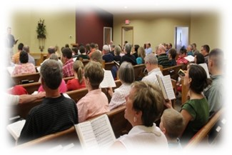
What You Miss Each Absence:
Edification (Eph. 4:12, 16; 5:19)
Giving Encouragement (Eph. 5:19; Heb. 10:24)
Praising God (Acts 2:42, 47)
Gaining knowledge (2 Pet. 3:18)

Slide 22
Made Weaker & Weaker the More You Miss
If attendance – makes me stronger… then missing makes me weaker.
The more I miss – weaker I get.
True – whether absence is justified or not!

Slide 23

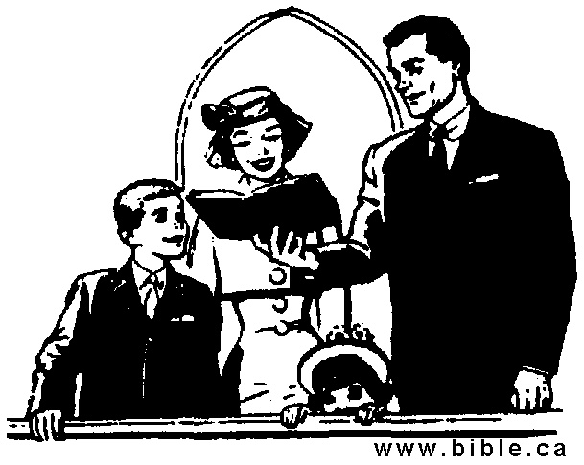
Weaker & Weaker
If One Does Not Eat
If One Does Not Attend
Can’t Help It
Can’t Eat
By Choice
Does Not Eat
Can’t Help It
Sick, etc.
By Choice
Don’t Come
Physically Weak
Spiritually Weak

Slide 24
Why Do Christians Get Weaker?
Fail to feed their faith (Col.1:9-11)
Fail to add to their faith – Diligent (2 Pet. 1:5-10)
Fail to exercise their faith (Luke 17:5-10)
Fail to check their faith (2 Cor. 13:5)
Miss services that strengthens their faith

Slide 25
Am I Getting Weaker?
If so, Why?
Goal: Be Strong and Growing
Possible to Get Weaker
Why Do Christians Get Weaker?

