Slide 1
The Nature of Sin (Nov. 10)
The Nature of Grace (Nov. 17)
Man’s Ability to Obey (Nov. 24)
Are We Under Law? (Dec. 1)
Faith and Works (Dec. 8)
How the Sinner is Forgiven (Dec. 15)
Imputed Righteousness (Dec. 22)
A Series
Notes:
Photo by Emmanuel Phaeton on Unsplash

Slide 2
Imputed Righteousness
“Imputed Righteousness” is one of the erroneous concepts about sin and grace
This is part of the doctrine of Calvinism (Classic)
Some of our own (non-institutional) brethren advocate it

Slide 3
Calvinism’s Concept of Imputed Righteousness
Calvinism’s Concept of Imputed Righteousness
Imputed
Righteousness
Notes:
Photo by Emmanuel Phaeton on Unsplash

Slide 4
Calvinism’s Concept of
Imputed Righteousness
Calvinism’s Concept of
Imputed Righteousness
Use the word “impute” to mean “transfer”
  Thus, this doctrine is a vicarious imputation
  So, imputed righteousness is a transfer of righteousness
Warning:
  If hear a person use “impute” – in sense of “transfer”
  If talks about the righteousness of Christ and implies it is TRANSFERRED to us
YOU ARE LISTENING TO ERROR!

Slide 5
Calvinism’s Concept of
Imputed Righteousness
Calvinism’s Concept of
Imputed Righteousness
Use the word “impute” to mean “transfer”
Threefold imputation or transfer in Calvinism
  Adam’s sin is imputed to man (transferred) – Hereditary Total Depravity
  Man’s sin is imputed to Christ (transferred) –
  The perfect righteousness of Christ is imputed to man (transferred) – Imputed Righteousness

Slide 6
Calvinism’s Concept of
Imputed Righteousness
Calvinism’s Concept of
Imputed Righteousness
Use the word “impute” to mean “transfer”
Threefold imputation or transfer in Calvinism
How Imputed Righteousness works
  Calvin himself stated: this means God doesn’t see our sin – he sees perfect righteousness when looks at us

Slide 7
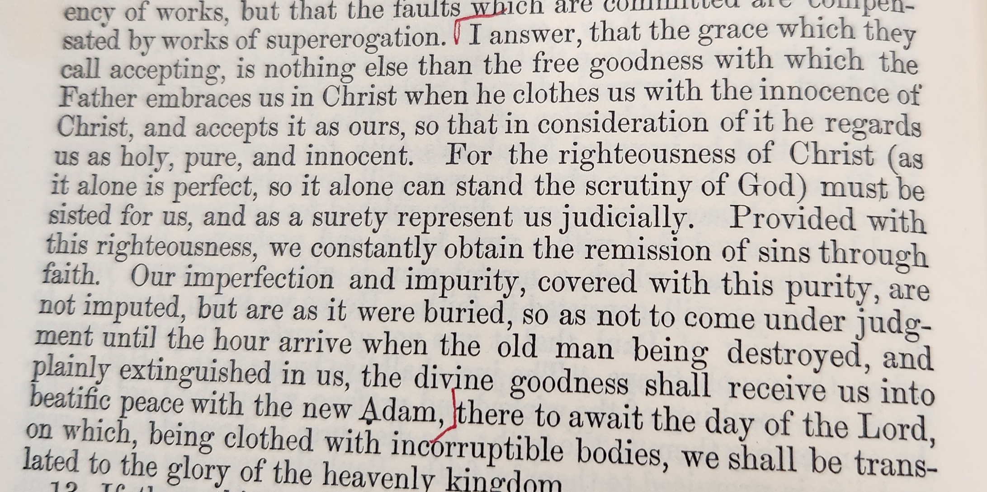
John Calvin, Institutes of Christian Religion, Vol. 2, p. 82

Slide 8
Calvinism’s Concept of
Imputed Righteousness
Calvinism’s Concept of
Imputed Righteousness
Use the word “impute” to mean “transfer”
Threefold imputation or transfer in Calvinism
How Imputed Righteousness works
  Calvin himself stated: this means God doesn’t see our sin – he sees perfect righteousness when looks at us
  Implies a constant – continual cleansing (or looking the other way)
  Complete obedience is not absolutely necessary
  The righteousness of Christ is like an umbrella over us

Slide 9


God Sees
Perfect
Righteousness of Christ
Sin
Sin
Sin
Sin
Error
Error
Sin

Slide 10
Calvinism’s Concept of Imputed Righteousness
Some Brethren teach Imputed Righteousness
Calvinism’s Concept of Imputed Righteousness
Some Brethren teach Imputed Righteousness
Imputed
Righteousness
Notes:
Photo by Emmanuel Phaeton on Unsplash

Slide 11
Some Brethren Teach
Imputed Righteousness
Some Brethren Teach
Imputed Righteousness
Don’t hold to the full classic Calvinism
  Don’t believe all of the TULIP
  Thus, they are Neo-Calvinism or Soft-Calvinist
  To be fair, we cannot charge any of them with believing classic Calvinism
  However, just because they refute Calvinism (deny believing it) DOES NOT mean they don’t hold to some part of it

Slide 12
Some Brethren Teach
Imputed Righteousness
Some Brethren Teach
Imputed Righteousness
Don’t hold to the full classic Calvinism
Unity movement of 1960’s & 1970’s (“New Unity Movement”) advocated this
  Among the advocates was Ed Fudge (Athen, AL) advocated Imputed Righteousness
  He and others concluded we could fellowship those we believe to be in doctrinal error (used the instrument, etc.)

Slide 13
Some Brethren Teach
Imputed Righteousness
Some Brethren Teach
Imputed Righteousness
Don’t hold to the full classic Calvinism
Unity movement of 1960’s & 1970’s (“New Unity Movement”) advocated this
Some among non-institutional brethren advocate this

Slide 14
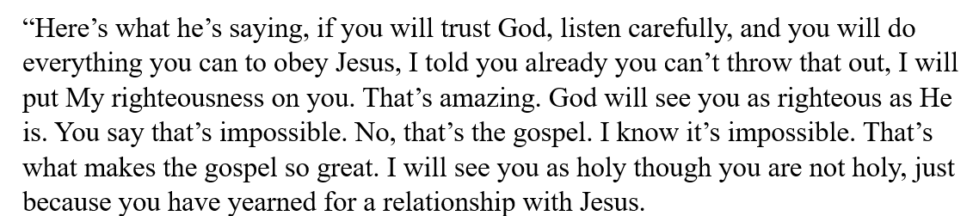
Brother 1

Slide 15
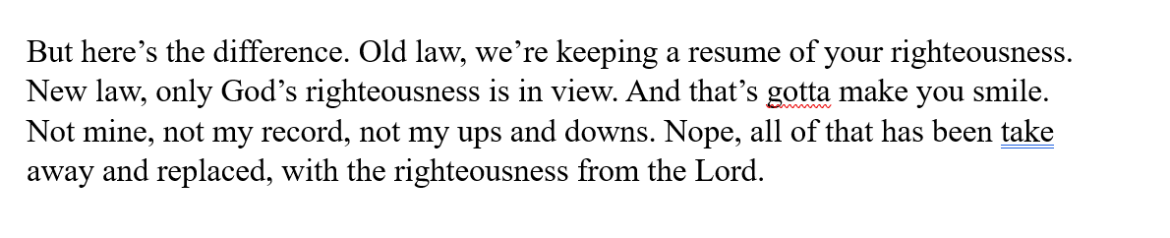
Brother 1

Slide 16
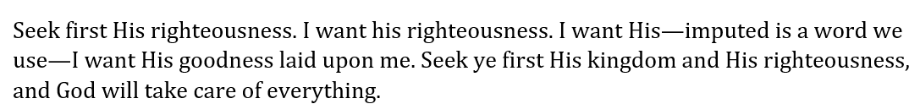
Brother 1

Slide 17
“Did you hear what he is saying here…We go out today and we represent Jesus, However you want to label that term, we represent Jesus as those who have been reconciled to God because that’s what he is saying in verse 21. He made him who knew no sin to be sin for us. He has taken our sins and it was credited to the Son, and taken the Son’s righteousness and credited it to us. Do you see that?”
Brother 2

Slide 18
Some Brethren Teach
Imputed Righteousness
Some Brethren Teach
Imputed Righteousness
Don’t hold to the full classic Calvinism
Unity movement of 1960’s & 1970’s (“New Unity Movement”) advocated this
Some among non-institutional brethren advocate this
Here is the danger
  What is being said is appealing & sounds so humble
  These are men who are used in meetings
  These are men who have influence on social media / podcast / YouTube, etc.

Slide 19
Calvinism’s Concept of Imputed Righteousness
Some Brethren teach Imputed Righteousness
Romans 4 Abused
Calvinism’s Concept of Imputed Righteousness
Some Brethren teach Imputed Righteousness
Romans 4 Abused
Imputed
Righteousness
Notes:
Photo by Emmanuel Phaeton on Unsplash

Slide 20
Romans 4 Abused
Romans 4 Abused
The word “impute” does not mean “transfer”
  Means to “reckon, calculate, count… consider” (BDAG)
  Louw – Nida:
“to keep records of commercial accounts, involving both debits and credits—‘to put into one’s account, to charge one’s account, to regard as an account.’ τῷ δὲ ἐργαζομένῳ ὁ μισθὸς οὐ λογίζεται κατὰ χάριν ἀλλὰ κατὰ ὀφείλημα ‘to a person who has worked, the wage is not regarded (or ‘not credited to his account’) as a gift but as a debt to be paid’ (or ‘a debt owed to him’) Ro 4:4.”
  Johannes P. Louw and Eugene Albert Nida, Greek-English Lexicon of the New Testament: Based on Semantic Domains (New York: United Bible Societies, 1996), 582.

Slide 21
Romans 4 Abused
Romans 4 Abused
The word “impute” does not mean “transfer”
  Means to “reckon, calculate, count… consider” (BDAG)
  Louw – Nida:
  Same word translated:
    “Counted” (v. 4; Phil. 3:13)
    “Accounted” (v. 5 NKJV)
    “Consider” (Rom. 8:18; 1 Cor. 4:1)
    “Reckon” (Rom. 6:11)
  No passage uses it as transferring

Slide 22
Romans 4 Abused
Romans 4 Abused
The word “impute” does not mean “transfer”
The righteousness imputed is not the righteousness of Christ
  Nothing is said about the righteousness of Christ
  The righteousness imputed is one’s own
    Not that one earns or deserves to be righteous
    But, God considers (counts) him righteous – upon his faith
    When Abraham believed God credited him as being righteous (v. 3)
    The sin imputed is one’s own (v. 8)
  If the righteousness is righteousness of Christ – would the sin be the sin of Christ?

Slide 23
Romans 4 Abused
Romans 4 Abused
The word “impute” does not mean “transfer”
The righteousness imputed is not the righteousness of Christ
Imputing righteousness = forgiveness of sins
  Verse 6-8 – imputing righteousness is equated with not imputing sin
  Quotes from Psa. 32 in verses 7-8
    Forgiven / sins covered (v. 1)
    Turned and sin now hidden (v. 5)
  Forgiven (v. 7)
  No longer considers him a sinner (v. 8)
  If forgiven:
    Not rewarded for perfect works!
    Sin not still there!

Slide 24
Romans 4 Abused
Romans 4 Abused
The word “impute” does not mean “transfer”
The righteousness imputed is not the righteousness of Christ
Imputing righteousness = forgiveness of sins
Look at 2 Cor. 5:21
  No evidence of transferring of anything
  Jesus was made to be sin = treated as a sinner and died like one (but he knew no sin) – compare 1 Pet. 2:24
  Second phrase: “righteousness” corresponds to “sin” in first phrase
  Point: God accepts as righteous those who he has reconciled
  Parallel phrases: in Christ (v. 17), new creation (v. 17), reconciled (v. 18), not imputing trespass (v. 19)

Slide 25
Calvinism’s Concept of Imputed Righteousness
Some Brethren teach Imputed Righteousness
Romans 4 Abused
Consequences / Problems
Calvinism’s Concept of Imputed Righteousness
Some Brethren teach Imputed Righteousness
Romans 4 Abused
Consequences / Problems
Imputed
Righteousness
Notes:
Photo by Emmanuel Phaeton on Unsplash

Slide 26
Consequences / Problems
Consequences / Problems
Based on a false concept of salvation by perfect obedience
  Begins with idea that every man must keep the law perfectly
  Man does not (and can not)
  Christ did keep the law perfectly (OT law) – so God transfers that to us
  Yet, they charge us with legalism!

Slide 27
Consequences / Problems
Consequences / Problems
Based on a false concept of salvation by perfect obedience
Eliminates obedience
  The perfect righteousness of Christ – is seen by God – not our failure
  Yet – obedience is essential (Matt. 7:21; Heb. 5:8-9)

Slide 28
Consequences / Problems
Consequences / Problems
Based on a false concept of salvation by perfect obedience
Eliminates obedience
Denies Ezek. 18:20
  Neither righteousness or sin is imputed to another
  Righteousness is imputed to the righteous and wickedness to the wicked

Slide 29
Consequences / Problems
Consequences / Problems
Based on a false concept of salvation by perfect obedience
Eliminates obedience
Denies Ezek. 18:20
Makes God a respecter of persons
  If imputed righteousness is true, then any Christian that is lost – it is God’s fault!
  God does not respect persons (Rom. 2:11)

Slide 30
Consequences / Problems
Consequences / Problems
Based on a false concept of salvation by perfect obedience
Eliminates obedience
Denies Ezek. 18:20
Makes God a respecter of persons
Comforts those in sin
  One who believes, teaches or practices error – comforted – if you are wrong – that’s okay
  One who sins – comforted – if you sin – that’s okay
  1 John 1:6-7; 2 John 9

Slide 31
Consequences / Problems
Consequences / Problems
Based on a false concept of salvation by perfect obedience
Eliminates obedience
Denies Ezek. 18:20
Makes God a respecter of persons
Comforts those in sin
Righteous while still a sinner
  The Christian is still a sinner – not forgiven all of he does (at least some argue)
  The umbrella of the perfect righteousness of Christ covers all that
  Compare 1 John 3:7

Slide 32
Calvinism’s Concept of Imputed Righteousness
Some Brethren teach Imputed Righteousness
Romans 4 Abused
Consequences / Problems
Calvinism’s Concept of Imputed Righteousness
Some Brethren teach Imputed Righteousness
Romans 4 Abused
Consequences / Problems
Imputed
Righteousness
Notes:
Photo by Emmanuel Phaeton on Unsplash

Slide 33
The Nature of Sin (Nov. 10)
The Nature of Grace (Nov. 17)
Man’s Ability to Obey (Nov. 24)
Are We Under Law? (Dec. 1)
Faith and Works (Dec. 8)
How the Sinner is Forgiven (Dec. 15)
Imputed Righteousness (Dec. 22)
A Series
Notes:
Photo by Emmanuel Phaeton on Unsplash

