Slide 1
The Nature of Sin (Nov. 10)
The Nature of Grace (Nov. 17)
Man’s Ability to Obey (Nov. 24)
Are We Under Law? (Dec. 1)
Faith and Works (Dec. 8)
How the Sinner is Forgiven (Dec. 15)
Imputed Righteousness (Dec. 22)
A Series
Notes:
Photo by Emmanuel Phaeton on Unsplash

Slide 2
Are Christians Under Law?
Old erroneous idea: Christians are not under law (but grace)
Seems to surface with each new generation
Often, some young Christians – get excited about rejection of “law keeping” – great emphasis on grace
Part of the “uncertain sounds” we hear today

Slide 3
Removing Law
Removing Law
Are We
Under Law?
Notes:
Photo by Emmanuel Phaeton on Unsplash

Slide 4
Removing Law
(What is being said and why)
Removing Law
(What is being said and why)
Statements being made today
“We are not saved by keeping God’s law”
“Salvation is not obtained by law keeping”
“God justifies human beings on faith, not adherence to law”
“No law brings eternal life”
“We cannot be saved by any law – old or new”
“We are no longer under a covenant characterized by law”
“Any law is powerless to save”

Slide 5
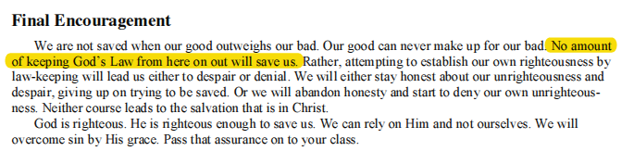
Removing Law
(What is being said and why)
Removing Law
(What is being said and why)

Slide 6
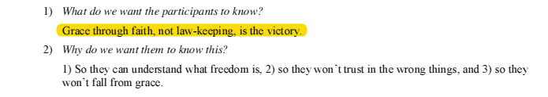
Removing Law
(What is being said and why)
Removing Law
(What is being said and why)

Slide 7
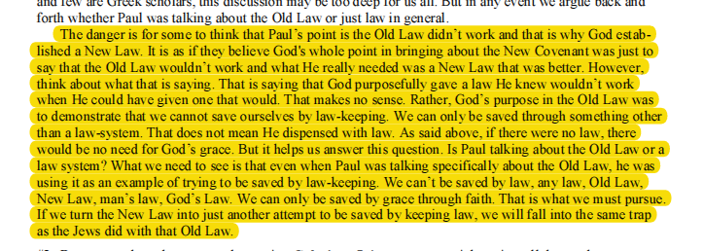
Removing Law
(What is being said and why)
Removing Law
(What is being said and why)

Slide 8
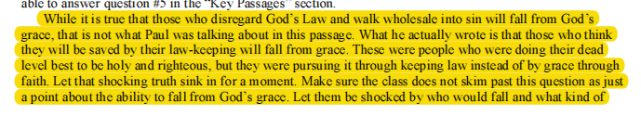
Removing Law
(What is being said and why)
Removing Law
(What is being said and why)

Slide 9
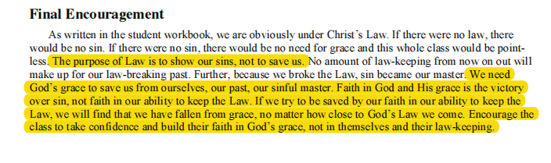
Removing Law
(What is being said and why)
Removing Law
(What is being said and why)

Slide 10

Removing Law
(What is being said and why)
Removing Law
(What is being said and why)

Slide 11
Removing Law
(What is being said and why)
Removing Law
(What is being said and why)
Talk about “law keeping” & “legalism” – as opposed to grace
Make it an either-or proposition
Law Keeping
“Legalism”
Depend on
Grace of God

Slide 12
Removing Law
(What is being said and why)
Removing Law
(What is being said and why)
When challenged: “Oh no. We are not saying we are not under law at all!”
At best: Very Careless Statements – leave wrong message!
“We are not saved by keeping God’s law”
“Salvation is not obtained by law keeping”
“God justifies human beings on faith, not adherence to law”
“No law brings eternal life”
“We cannot be saved by any law – old or new”
“We are no longer under a covenant characterized by law”
“Any law is powerless to save”

Slide 13
Removing Law
(What is being said and why)
Removing Law
(What is being said and why)
Statements being made today
Why all the talk about not being under law?
  Offsets any plea for strict adherence / conformity
  God will not hold us to legal requirements
  Makes room / allowances:
    Teaching – with which we strongly disagree
    Practices – we admit are not in Bible
    Loose living – moral questions

Slide 14
Removing Law
Under Law
Removing Law
Under Law
Are We
Under Law?
Notes:
Photo by Emmanuel Phaeton on Unsplash

Slide 15
Under Law
(Principles and Passages Ignored)
Under Law
(Principles and Passages Ignored)
We are subject to law
Rom 8:2
For the law of the Spirit of life in Christ Jesus has made me free from the law of sin and death.

Slide 16
Under Law
(Principles and Passages Ignored)
Under Law
(Principles and Passages Ignored)
We are subject to law
1 Cor 9:21
to those who are without law, as without law (not being without law toward God, but under law toward Christ), that I might win those who are without law;

Slide 17
Under Law
(Principles and Passages Ignored)
Under Law
(Principles and Passages Ignored)
We are subject to law
Gal 6:2
Bear one another's burdens, and so fulfill the law of Christ.

Slide 18
Under Law
(Principles and Passages Ignored)
Under Law
(Principles and Passages Ignored)
We are subject to law
James 1:25
But he who looks into the perfect law of liberty and continues in it, and is not a forgetful hearer but a doer of the work, this one will be blessed in what he does.

Slide 19
Under Law
(Principles and Passages Ignored)
Under Law
(Principles and Passages Ignored)
We are subject to law
James 2:12
So speak and so do as those who will be judged by the law of liberty.

Slide 20
Under Law
(Principles and Passages Ignored)
Under Law
(Principles and Passages Ignored)
We are subject to law
1 John 3:4
Whosoever committeth sin transgresseth also the law: for sin is the transgression of the law.
KJV

Slide 21
Under Law
(Principles and Passages Ignored)
Under Law
(Principles and Passages Ignored)
We are subject to law
2 Tim 2:5
And if a man also strive for masteries, yet is he not crowned, except he strive lawfully.
KJV

Slide 22
Under Law
(Principles and Passages Ignored)
Under Law
(Principles and Passages Ignored)
We are subject to law
God’s word is law
Isa 2:3
Many people shall come and say, "Come, and let us go up to the mountain of the LORD, To the house of the God of Jacob; He will teach us His ways, And we shall walk in His paths." For out of Zion shall go forth the law, And the word of the LORD from Jerusalem.

Slide 23
Under Law
(Principles and Passages Ignored)
Under Law
(Principles and Passages Ignored)
We are subject to law
God’s word is law
Psalm 19:7-8
7 The law of the LORD is perfect, converting the soul; The testimony of the LORD is sure, making wise the simple;
8 The statutes of the LORD are right, rejoicing the heart; The commandment of the LORD is pure, enlightening the eyes;

Slide 24
Under Law
(Principles and Passages Ignored)
Under Law
(Principles and Passages Ignored)
We are subject to law
God’s word is law
Psalm 119:1, 9
1 Blessed are the undefiled in the way, Who walk in the law of the LORD!
9 How can a young man cleanse his way? By taking heed according to Your word.

Slide 25
Under Law
(Principles and Passages Ignored)
Under Law
(Principles and Passages Ignored)
We are subject to law
God’s word is law
Jer 31:31-34
31 "Behold, the days are coming, says the LORD, when I will make a new covenant with the house of Israel and with the house of Judah--
33 But this is the covenant that I will make with the house of Israel after those days, says the LORD: I will put My law in their minds, and write it on their hearts; and I will be their God, and they shall be My people.

Slide 26
Under Law
(Principles and Passages Ignored)
Under Law
(Principles and Passages Ignored)
We are subject to law
God’s word is law
Obedience suggest commands / law
  Must obey to enter kingdom (Matt. 7:21)
  Must obey to have eternal life (Heb. 5:8-9)
  Must do commandments to enter heaven (Rev. 22:14)

Slide 27
Under Law
(Principles and Passages Ignored)
Under Law
(Principles and Passages Ignored)
We are subject to law
God’s word is law
Obedience suggest commands / law
Law is not opposed to grace
  Grace does not mean we are not subject to law
    Salvation is by grace (Eph. 2:5, 8)
    Grace provides forgiveness when violate the law
  2. Grace of God teaches us what to do (Titus 2:11-12)

Slide 28
Removing Law
Under Law
Passages Abused
Removing Law
Under Law
Passages Abused
Are We
Under Law?
Notes:
Photo by Emmanuel Phaeton on Unsplash

Slide 29
Passages Abused
(Passages Saying – Not Under Law)
Passages Abused
(Passages Saying – Not Under Law)
John 1:17
  If saying not under law – then contradicts simple passages
  Contrast Moses – Christ
  If no law under Christ – then no grace or truth under Moses?
  Context (vv. 14-17)
    Jesus (Word) became flesh (v. 14)
    Christ brings an abundance of grace (v. 15-16)
    Access grace through Christ – not Moses (v. 17)

Slide 30
Passages Abused
(Passages Saying – Not Under Law)
Passages Abused
(Passages Saying – Not Under Law)
John 1:17
Rom. 6:14-15
  If saying not under law – then contradicts simple passages
  Context: sin not reign in body (vv. 1, 12)
  Either all law or particular law (Moses) or mere law
  Under law of Christ for obeyed doctrine (v. 17)
  Not under the condemnation of law
  Grace provides forgiveness for violation of law

Slide 31
Passages Abused
(Passages Saying – Not Under Law)
Passages Abused
(Passages Saying – Not Under Law)
John 1:17
Rom. 6:14-15
Gal. 5:18
  If saying not under law – then contradicts simple passages
  Context / point of book – not justified by works of law of Moses (2:16; 3:10-14)
  Under law (6:2)

Slide 32
Point of John 1:17 and Rom. 6:14-15?
Old Testament
Was law (Exo. 20)
Was grace (Gen.6:8)
Was faith (Gen. 15:6)
Law pointed out sin didn’t justify
(Rom. 3:20-21)
New Testament
Is law (Jas. 1:25)
Is grace (Eph. 2:8)
Is faith (Eph. 2:8)
Complete forgiveness
through Christ
(Heb. 8:12)

Slide 33
Removing Law
Under Law
Passages Abused
Consequences Faced
Removing Law
Under Law
Passages Abused
Consequences Faced
Are We
Under Law?
Notes:
Photo by Emmanuel Phaeton on Unsplash

Slide 34
Consequences Faced
(Reality of Not Being Under Law)
Consequences Faced
(Reality of Not Being Under Law)
No sin (1 John 3:4; Rom. 4:15)
  Since sin is a transgression of the law (no law – no sin)
  Thus, no error today!
  Thus, no wrong-doing today!

Slide 35
Consequences Faced
(Reality of Not Being Under Law)
Consequences Faced
(Reality of Not Being Under Law)
No sin (1 John 3:4; Rom. 4:15)
Word is powerless to save (Rom. 1:16; Jas. 1:21; Acts 11:14)
  We have shown that the word is the law
  Thus, if we are not saved by any law – not saved by the word!

Slide 36
Consequences Faced
(Reality of Not Being Under Law)
Consequences Faced
(Reality of Not Being Under Law)
No sin (1 John 3:4; Rom. 4:15)
Word is powerless to save (Rom. 1:16; Jas. 1:21; Acts 11:14)
Saved without hearing (John 5:24; Acts 2:22)
  We have shown that the word is the law
  Thus, if we are not saved by any law – not saved hearing the word!

Slide 37
Consequences Faced
(Reality of Not Being Under Law)
Consequences Faced
(Reality of Not Being Under Law)
No sin (1 John 3:4; Rom. 4:15)
Word is powerless to save (Rom. 1:16; Jas. 1:21; Acts 11:14)
Saved without hearing (John 5:24; Acts 2:22)
New covenant not binding
  New covenant is law (Jer. 31)
  If not under law – not under new covenant

Slide 38
Removing Law
Under Law
Passages Abused
Consequences Faced
Removing Law
Under Law
Passages Abused
Consequences Faced
Are We
Under Law?
Notes:
Photo by Emmanuel Phaeton on Unsplash

Slide 39
The Nature of Sin (Nov. 10)
The Nature of Grace (Nov. 17)
Man’s Ability to Obey (Nov. 24)
Are We Under Law? (Dec. 1)
Faith and Works (Dec. 8)
How the Sinner is Forgiven (Dec. 15)
Imputed Righteousness (Dec. 22)
A Series
Notes:
Photo by Emmanuel Phaeton on Unsplash

