Slide 1
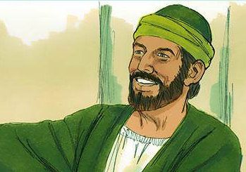
Introduced to Barnabas
Acts 4:32-37
32 Now the multitude of those who believed were of one heart and one soul; neither did anyone say that any of the things he possessed was his own, but they had all things in common.
33 And with great power the apostles gave witness to the resurrection of the Lord Jesus. And great grace was upon them all.
34 Nor was there anyone among them who lacked; for all who were possessors of lands or houses sold them, and brought the proceeds of the things that were sold,
35 and laid them at the apostles' feet; and they distributed to each as anyone had need.

Slide 2
Introduced to Barnabas
Acts 4:32-37
36 And Joses, who was also named Barnabas by the apostles (which is translated Son of Encouragement), a Levite of the country of Cyprus,
37 having land, sold it, and brought the money and laid it at the apostles' feet.

Slide 3
The Man Barnabas
Name:
  Joses [Joseph] - (Acts 4:36)
  Barnabas (Acts 4:36)
    Given to him by Apostles
    Means: Son of Encouragement
Levite (Acts 4:36)
Family: Cousin to John Mark (Col. 4:10)
Some Wealth: Sold land (Acts 4:32-37)
Place: Island of Cyrus (Acts 4:36)

Slide 4
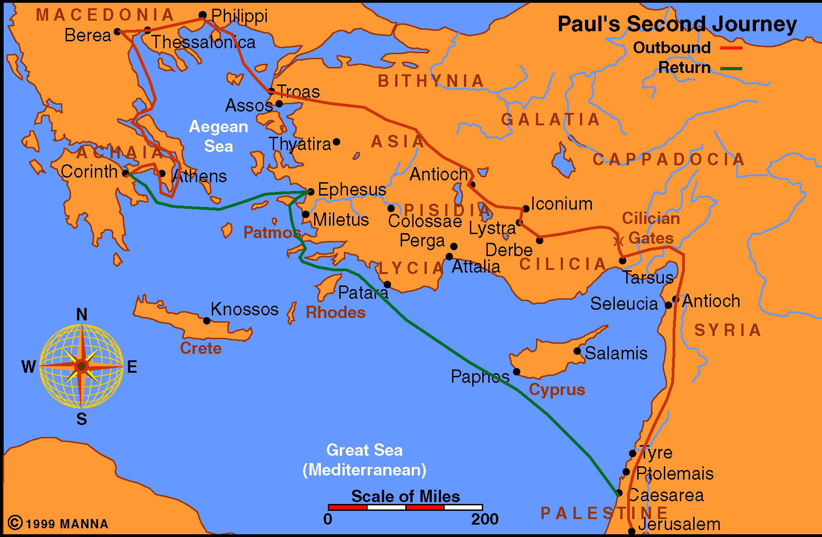

Slide 5
The Man Barnabas
Qualities: Good man, full of Holy Spirit & Faith (Acts 11:24)
Ability to Encourage: (Acts 4:36; 11:23)
Bold: (Acts 13:46)
Self Denial: (1 Cor. 9:6)

Slide 6
Overview of His Life
Sold & gave to help needy (Acts 4:32-37)
Vouched for Saul at Jerusalem(Acts 9:26-28)
At Antioch (Acts 11:22-30)
  Sent by church at Jerusalem (v. 22)
  Encouraged & taught (vv. 23-24)
  Went to Tarsus for Saul (v. 25)
  Worked for a year & taught (v. 26)
Messenger of benevolence to Judea (Acts 11:27-30)

Slide 7
Overview of His Life
Returned to Antioch with John Mark (Acts 12:25)
Sent out on 1st Journey with Paul (Acts 13-14)
  Preached in home area (13:4-12)
  Expelled from Antioch (13:50)
  Attempt made to worship him (14:12-18)
  Revisited churches (14:21-28)
Dispute at Antioch over circumcision (Acts 15:1-2)

Slide 8
Overview of His Life
Jerusalem discussion (Acts 15: 12, 25, 35)
Dispute with Paul over John Mark (Acts 15:36-41)
Traveled on his own missionary journey (Acts 15:39)
Disappears from the record
Hypocrisy (Gal. 2:13)

Slide 9
Barnabas
Son of Encouragement
Characteristics That Gave Him That Name

Slide 10
Barnabas
Son of Encouragement
Caring & Generous

Slide 11
Caring & Generous
Money & Possessions (Acts 4:32-37)
Time (Acts 11:30)
Care & Love for Others (Acts 4, 9, 11)

Slide 12
Barnabas
Son of Encouragement
Caring & Generous
Commended & Recommended

Slide 13
Commended & Recommended
Vouched for Saul (Acts 9:27-28)
Willing to stake his name & reputation for another
Used his influence to help others be accepted and used

Slide 14
Barnabas
Son of Encouragement
Caring & Generous
Commended & Recommended
Saw Potential

Slide 15
Saw Potential
John Mark turned back (Acts 13:13)
Stood by him for 2nd journey (Acts 15:36-41)
Confidence was well placed (Col. 4:10)
Learn:
Saw good / potential – even after failure!
Sought reconciliation
Didn’t give up on him

Slide 16
Barnabas
Son of Encouragement
Caring & Generous
Commended & Recommended
Saw Potential
Motivator

Slide 17
Motivator
Involved Saul in work at Jerusalem (Acts 9:26-28)
Involved Saul in work at Antioch (Acts 11:22-26)
Involved Mark in missionary work (Acts 12:25; 15:36-41)

Slide 18
Barnabas
Son of Encouragement
Caring & Generous
Commended & Recommended
Saw Potential
Motivator
Urged Faithfulness

Slide 19
Urged Faithfulness
At Antioch (Acts 11:23)
In churches just established (Acts 14:22)

Slide 20
Barnabas
Son of Encouragement
Caring & Generous
Commended & Recommended
Saw Potential
Motivator
Urged Faithfulness
Evangelistic

Slide 21
Evangelistic
Traveled with Paul on 1st journey (Acts 13:2-3, 43)
Traveled with John Mark on his own 2nd journey (Acts 15:39)

Slide 22
Barnabas
Son of Encouragement
Caring & Generous
Commended & Recommended
Saw Potential
Motivator
Urged Faithfulness
Evangelistic
Boldly Stood for the Truth

Slide 23
Boldly Stood for the Truth
When faced opposition (Acts 13:44-50)
At Antioch – then Jerusalem (Acts 15:1-2, 12, 25, 35)

Slide 24
Barnabas
Son of Encouragement
Caring & Generous
Commended & Recommended
Saw Potential
Motivator
Urged Faithfulness
Evangelistic
Boldly Stood for the Truth

