Slide 1
The Nature of Sin (Nov. 10)
The Nature of Grace (Nov. 17)
Man’s Ability to Obey (Nov. 24)
Are We Under Law? (Dec. 1)
Faith and Works (Dec. 8)
How the Sinner is Forgiven (Dec. 15)
Imputed Righteousness (Dec. 22)
A Series
Notes:
Photo by Emmanuel Phaeton on Unsplash

Slide 2
How the Sinner is Forgiven
Sin is the reason man needs forgiveness (Rom. 7:24)
  All have sinned (Rom. 3:9, 23)
  Sin when we reach point of accountability (Rom. 7:9)
  Sin separates from God (Rom. 7:9; Isa. 59:1-2)
How is he forgiven? How is he made righteous?
Saved (forgiven, righteous) by God’s grace (Tit. 2:11-12)
Discuss forgiveness for the alien sinner & the Christian

Slide 3
How Grace Offers Forgiveness
How Grace Offers Forgiveness
How the Sinner is Forgiven
Notes:
Photo by Emmanuel Phaeton on Unsplash

Slide 4
How Grace Offers Forgiveness
How Grace Offers Forgiveness
False views of grace
  Warnings in the NT about abusing grace
    Possible to teach a false grace (cf. 1 Pet. 5:12)
    Possible to turn grace into licentiousness (Jude 4)
    Possible to make grace a license to sin (1 Pet. 2:16; Gal. 5:13; Rom. 6:1, 14)

Slide 5
How Grace Offers Forgiveness
How Grace Offers Forgiveness
False views of grace
  Warnings in the NT about abusing grace
  Unconditional grace (Classic Calvinism)
  God will overlook sin – “turn the other way”
  Second work of grace
    Justification – 1st work of grace – God removes the sin (guilt)
    Sanctification – 2nd work of grace – God removes the Adamic sinful nature
    Held by the Wesleyans (Methodist, Holiness, Pentecostal)
    The 2nd work (“entire sanctification”) comes with baptism of Holy Spirit

Slide 6
How Grace Offers Forgiveness
How Grace Offers Forgiveness
False views of grace
  Warnings in the NT about abusing grace
  Unconditional grace (Classic Calvinism)
  God will overlook sin – “turn the other way”
  Second work of grace
  Automatic forgiveness (continuous cleansing)
  Imputed righteousness (perfect righteousness of Christ is transferred to us)
  Time removes the sin – fades away

Slide 7
How Grace Offers Forgiveness
How Grace Offers Forgiveness
False views of grace
Grace provided a perfect blood sacrifice (Heb. 2:9)
  Sin (by its nature) demands that a penalty be paid
    Sin is a violation of the law (1 John 3:4)
    Man cannot pay to redeem himself
    God has always demanded blood sacrifices
      Reason: life is in the blood (Gen. 9:4; Lev. 17:1-14; Deut. 12:23)
      Animal blood will not work (Heb. 10:4)
      Perfect blood sacrifice: blood of Christ (1 Pet. 1:19)

Slide 8
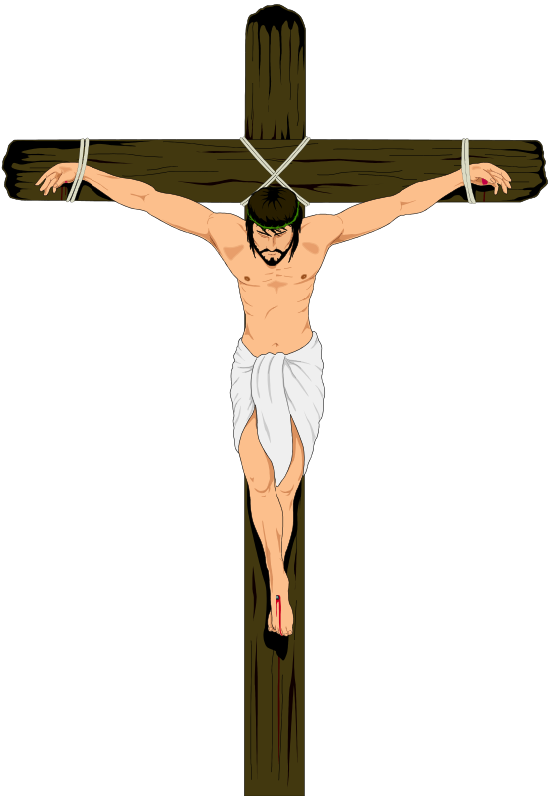
How Grace Offers Forgiveness
How Grace Offers Forgiveness
False views of grace
Grace provided a perfect blood sacrifice (Heb. 2:9)
  Sin (by its nature) demands that a penalty be paid
  Saved by the blood of Christ
    Remits sin (Matt. 26:28)
    Redeems (Eph. 1:7)
    Forgives (Col. 1:14)
    Reconciles (Col. 1:20)
    Washes (Rev. 1:5)
    Cleanses (1 Jno. 1:7)

Slide 9
How Grace Offers Forgiveness
How Grace Offers Forgiveness
False views of grace
Grace provided a perfect blood sacrifice (Heb. 2:9)
  Sin (by its nature) demands that a penalty be paid
  Saved by the blood of Christ
  Blood had to be offered in heaven
    As our High Priest offers his sacrifice (blood) in the most holy place (Heb. 9:12, 24)
    This is how we are saved by his life – resurrected life (Rom. 4:25; 5:10)

Slide 10

How Grace Offers Forgiveness
How Grace Offers Forgiveness
False views of grace
Grace provided a perfect blood sacrifice (Heb. 2:9)
  Sin (by its nature) demands that a penalty be paid
  Saved by the blood of Christ
  Blood had to be offered in heaven
  Blood was shed for those under the OT as well (Rom. 3:25; Heb. 9:15)

Slide 11
How Grace Offers Forgiveness
How Man Obtains Forgiveness
How Grace Offers Forgiveness
How Man Obtains Forgiveness
How the Sinner is Forgiven
Notes:
Photo by Emmanuel Phaeton on Unsplash

Slide 12
How Man Obtains Forgiveness
How Man Obtains Forgiveness
Grace is offered to all, but not all are saved
  Grace is offered to all
    Grace appeared to all men (Titus 2:11-12)
    Grace provided a sacrifice for every man (Heb. 2:9)
    God wants all men to be saved (1 Tim. 2:4)

Slide 13
How Man Obtains Forgiveness
How Man Obtains Forgiveness
Grace is offered to all, but not all are saved
  Grace is offered to all
  Not all men will be saved
    Possible to receive grace in vain (2 Cor. 6:1)
    Most of the world will be lost (Matt. 7:13-14)

Slide 14
How Man Obtains Forgiveness
How Man Obtains Forgiveness
Grace is offered to all, but not all are saved
  Grace is offered to all
  Not all men will be saved
  So, grace must be conditional
    Those that obey will enter the kingdom (Matt. 7:21)
    Those who obey will have eternal life (Heb. 5:8-9)

Slide 15
How Man Obtains Forgiveness
How Man Obtains Forgiveness
Grace is offered to all, but not all are saved
Forgiveness clarified
  Word (Eph. 1:7) Aphesis means pardon – translated “remission” (Acts 2:38), “liberty” (Lk. 4:18)
  Word (1 John 1:9) Aphiemi means leave – translated “divorce” (1 Cor. 7:11, 12, 13), “forsook” (Matt. 26:56)
  Word (Luke 6:37) Apolyo means release, let go – translated “dismiss” (Acts 19:41), “divorce” (Matt. 5:32; 19:9), “release” (Matt. 27:17)

Slide 16
How Man Obtains Forgiveness
How Man Obtains Forgiveness
Grace is offered to all, but not all are saved
Forgiveness clarified
Alien sinner
  The conditions:
    Faith (Acts 2:36)
    Repentance (Acts 17:11)
    Confession of faith (Rom. 10:9-10)
    Baptism (Acts 2:38)

Slide 17
How Man Obtains Forgiveness
How Man Obtains Forgiveness
Grace is offered to all, but not all are saved
Forgiveness clarified
Alien sinner
  The conditions:
  Now forgiven – sin has been remitted
    Acts 2:38
    Eph. 1:7; 4:32
    Col. 1:14

Slide 18
How Man Obtains Forgiveness
How Man Obtains Forgiveness
Grace is offered to all, but not all are saved
Forgiveness clarified
Alien sinner
  The conditions:
  Now forgiven – sin has been remitted
  God removes the GUILT – not the consequences

Slide 19
How Man Obtains Forgiveness
How Man Obtains Forgiveness
Grace is offered to all, but not all are saved
Forgiveness clarified
Alien sinner
Christian who sins
  The conditions:
    Repentance (Acts 8:22)
      Change of mind
        “Change one’s mind, feel remorse…” (BDAG)
        “to change one’s way of life as the result of a complete change of thought and attitude with regard to sin and righteousness” (Louw and Nida)

Slide 20
Louw and Nida Comments on Word for Repent
“Though in English a focal component of repent is the sorrow or contrition that a person experiences because of sin, the emphasis in μετανοέω and μετάνοια seems to be more specifically the total change, both in thought and behavior, with respect to how one should both think and act.”
  Greek-English Lexicon of the New Testament: Based on Semantic Domains (New York: United Bible Societies, 1996), 509.

Slide 21
How Man Obtains Forgiveness
How Man Obtains Forgiveness
Grace is offered to all, but not all are saved
Forgiveness clarified
Alien sinner
Christian who sins
  The conditions:
    Repentance (Acts 8:22)
      Change of mind
      Godly sorrow
        2 Cor. 7:10 – sorrow according to God
        NKJV clarifies what the KJV confuses: a distinction in sorrow, regret, and repentance
        Sorrow toward God that produces a change of mind

Slide 22
How Man Obtains Forgiveness
How Man Obtains Forgiveness
Grace is offered to all, but not all are saved
Forgiveness clarified
Alien sinner
Christian who sins
  The conditions:
    Repentance (Acts 8:22)
      Change of mind
      Godly sorrow
      Change of life
        Rev. 2:5
        Matt. 3:8
        Compare Matt. 12:41 & Jonah 3:10

Slide 23
Repentance
Godly
Sorrow
A Change
of Life
A Change
of Mind
Produces
Produces

Slide 24
How Man Obtains Forgiveness
How Man Obtains Forgiveness
Grace is offered to all, but not all are saved
Forgiveness clarified
Alien sinner
Christian who sins
  The conditions:
  Now forgiven / cleansed (1 John 1:7, 9; Acts 8:22)
  Must embrace forgiveness – forgive self (Psa. 32; 51)

Slide 25
How Grace Offers Forgiveness
How Man Obtains Forgiveness
How Man is Assured of Forgiveness
How Grace Offers Forgiveness
How Man Obtains Forgiveness
How Man is Assured of Forgiveness
How the Sinner is Forgiven
Notes:
Photo by Emmanuel Phaeton on Unsplash

Slide 26
How Man is Assured of Forgiveness
How Man is Assured of Forgiveness
The child of God needs balance

Slide 27

How can we balance assurance with the danger of falling?
How can I know that I am right with God?
We all sin – I am not perfect – can I still have hope?
All sin
Careful
Could Fall
Hope
Assurance
Possible that I am failing in areas I don’t even know?

Slide 28
How Man is Assured of Forgiveness
How Man is Assured of Forgiveness
The child of God needs balance
The child of God can know he is a faithful Christian
  Can know our names are written in heaven (Luke 10:20)
  Can know that we are children of God (Rom. 8:16)

Slide 29
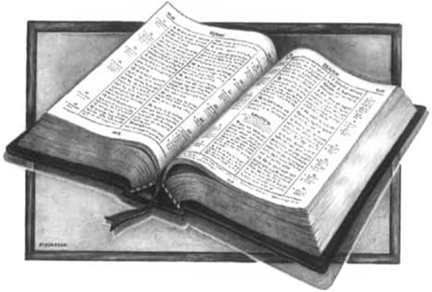
How Man is Assured of Forgiveness
How Man is Assured of Forgiveness
The child of God needs balance
The child of God can know he is a faithful Christian
The child of God can be assured
  Comes as result of being justified by faith (Rom. 5:1-5)
  Can have full assurance (Heb. 10:22)
  Can know we have eternal life (1 John 2:25; 5:13)
Hope
Any Danger
Any Warning
Must be Balanced
Desire + Expectation

Slide 30
How Man is Assured of Forgiveness
How Man is Assured of Forgiveness
The child of God needs balance
The child of God can know he is a faithful Christian
The child of God can be assured
The Christian life is not that hard
  Can know the will of God (Eph. 5:17)
  Can know I’m doing the will of God (2 Cor. 13:5)
  Not one command that we can’t understand or do
    Not continue in sin (Rom. 6)
    Relationships (Rom. 12-13)
    Lord’s Supper in worthy manner (1 Cor. 11)
    Give (1 Cor. 16:1-2)
    Put on new man (Eph. 4:17-32; Col. 3:10-25)
    Put off sin (Gal. 5:19-21; 1 Cor. 6:9-11)

Slide 31
How Grace Offers Forgiveness
How Man Obtains Forgiveness
How Man is Assured of Forgiveness
How Grace Offers Forgiveness
How Man Obtains Forgiveness
How Man is Assured of Forgiveness
How the Sinner is Forgiven
Notes:
Photo by Emmanuel Phaeton on Unsplash

Slide 32
The Nature of Sin (Nov. 10)
The Nature of Grace (Nov. 17)
Man’s Ability to Obey (Nov. 24)
Are We Under Law? (Dec. 1)
Faith and Works (Dec. 8)
How the Sinner is Forgiven (Dec. 15)
Imputed Righteousness (Dec. 22)
A Series
Notes:
Photo by Emmanuel Phaeton on Unsplash

