Slide 1

Recent Study

Slide 2
There are Times We All Need
Encouragement & Comfort
Because we get discouraged!
“Discouragement” may be minor or depression
There are legitimate reasons for being discouraged –
Thus, legitimate need for encouragement
“I am discouraged” is often a code for – “I know I am not doing right, but it is your fault”

Slide 3
How “Discouragement” Works
(Num. 21:4-5)
Situation: Israel had been forbidden to pass through Edom (Num. 20:20-21)

Slide 4
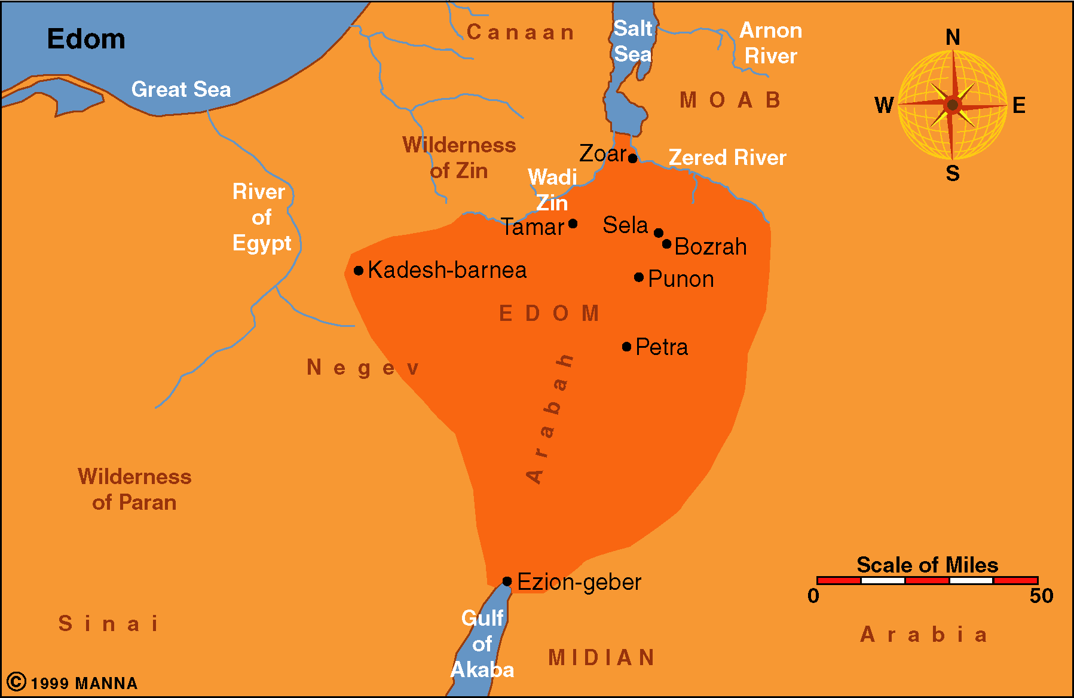
. Mt. Hor?

Slide 5
How “Discouragement” Works
(Num. 21:4-5)
Situation: Israel had been forbidden to pass through Edom (Num. 20:20-21)
“Very discouraged” (v. 4)- “Impatient” (ESV, NASB) – things are not going as planned –
“Because of the way” (ASV, NASB, KJV fn)
  Not just on the way – but because of it!
  Took longer – not as planned – rough
Turned against God (v. 5)
Complained (v. 5)

Slide 6
How “Discouragement” Works
(Num. 21:4-5)
Things Don’t Go Your Way
Not as Planned
Harder than Expected
Discouraged - Impatient
Turn Away from God
Complain

Slide 7
God Comforts the Downcast
(2 Cor. 7:6)
“troubled” (NCV)
“depressed” (NASB)
“discouraged” (NLT)
Conclude:
The comfort & encouragement I need – God gives
We are to comfort the “fainthearted” (1 Thess. 5:14)

Slide 8

Encouragement
& Comfort

Slide 9
Encouragement
& Comfort
What it Means to Encourage

Slide 10
What it Means to Encourage
Does not Mean:
  Assuring one that problems – not their fault
  Taking full responsibility for another’s spiritual condition
  Staying all positive
  Giving some “false” hope

Slide 11
What it Means to Encourage
Does not Mean:
Does Mean: To enable another to meet their difficultly with confidence
  What was needed in Num. 21:4-5
  Col. 2:1-2 – Paul’s struggles encouraged others

Slide 12

Barclay on Colossians 2:2
“Paul prays that their hearts may be encouraged. The word which he uses is parakalein. Sometimes that word means to comfort, sometimes to exhort; but always behind it there is the idea of enabling a person to meet some difﬁcult situation bravely and with conﬁdence. One of the Greek historians uses it in a most interesting and thought-provoking way. There was a Greek regiment which had lost heart and was utterly dejected. The general sent a leader to talk to it to such purpose that courage was reborn and a body of dispirited men became ﬁt again for heroic action. That is what parakalein means here. It is Paul’s prayer that the church may be ﬁlled with that courage which can cope with any situation.”
  Barclay, William (3rd ed. fully rev. and updated, p. 150)

Slide 13
What it Means to Encourage
Does not Mean:
Does Mean: To enable another to meet their difficultly with confidence
  What was needed in Num. 21:4-5
  Col. 2:1-2 – Paul’s struggles encouraged others
  Vines: lit. denotes “to call to one’s side,” hence, “to call to one’s aid.” It is used for every kind of calling to a person which is meant to produce a particular effect, hence, with various meanings, such as “comfort, exhort, desire, call for,” in addition to its significance “to beseech,” which has a stronger force than aiteo (see ask)

Slide 14
Encouragement
& Comfort
What it Means to Encourage
How One is Encouraged

Slide 15
How One is Encouraged
By Clarity of Revelation in the Midst of Controversy (Acts 15:30-32)
By Being with Those Who Focus on Others & Not Self (Acts 16:40)
By Being Assured of Promises in the Storm (Acts 27:36)
By Being with the Faithful (Rom. 1:12; Phil. 2:19; Col. 2:2)
By Learning the Revelation of God (1Cor. 14:31(cf. v. 3); Rom. 15:4; 1 Thess. 4:18)
By Having & Using Wisdom (Col. 2:2)

Slide 16
Barclay on Colossians 2:2
“Paul here uses three words for wisdom. In verse 2, he uses sunesis, which the Revised Standard Version translates as understanding. We have already seen in our discussion of Colossians 1:9 that sunesis is what we might call critical knowledge. It is the ability to assess any situation and decide what practical course of action is necessary within it. A real church will have the practical knowledge of what to do whenever action is called for.”
  Barclay, William (3rd ed. fully rev. and updated, pp. 150-151).

Slide 17
Encouragement
& Comfort
What it Means to Encourage
How One is Encouraged
Refusing to be Encouraged

Slide 18
Refusing to be Encouraged
Possible Some Refused to be Encouraged
  Can refuse comfort
    Gen. 37:34-35
    Psa. 77:2
    Jer. 31:15 (Matt. 2:18)
  Learn: have to accept / receive encouragement

Slide 19

Refusing to be Encouraged
Possible Some Refused to be Encouraged
Some Stay Discouraged – Because Refuse Encouragement
  Don’t like what Revelation says
  Don’t want to focus on others
  Don’t want to be with the faithful
  Don’t want to go in direction that is difficult
  Don’t want to use wisdom

Slide 20
Encouragement
& Comfort
What it Means to Encourage
How One is Encouraged
Refusing to be Encouraged

