Slide 2




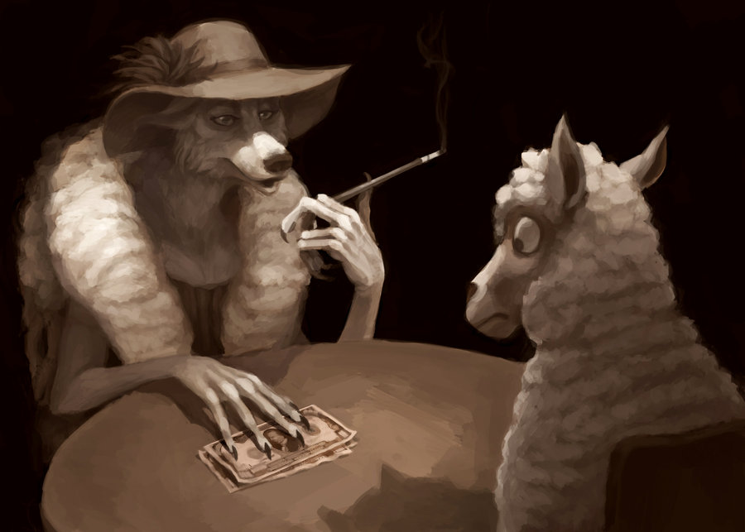


Slide 3









Slide 4





Slide 5


Fornication: (Porneia)
Unlawful Sexual Intercourse
How I Got Here
Uncleanness: (Akatharsia) Moral Impurity
Did not cut off
the Supply Line
Passion: (Pathos) Depraved, Vile Lust
Evil Desire: (Kakos) Sinful Thoughts
Covetousness: (Pleonexia) Desire for More

