Slide 1
The Nature of Sin (Nov. 10)
The Nature of Grace (Nov. 17)
Man’s Ability to Obey (Nov. 24)
Are We Under Law? (Dec. 1)
Faith and Works (Dec. 8)
How the Sinner is Forgiven (Dec. 15)
Imputed Righteousness (Dec. 22)
A Series
Notes:
Photo by Emmanuel Phaeton on Unsplash

Slide 2
Does Man Have the Ability to Obey God’s Word?
Why ask such a question?
If you could be convinced that you are not totally capable of living right – would it make a difference?
  That you cannot help but sin?
  That you cannot understand God’s revelation without divine intervention?
  That you cannot do what God commands without God acting?
Absolutely would!
  That puts all responsibility on God!
  If you sin, you can’t really help it!
  Know you can’t really do all God says – can’t measure up!
Concept is taught today – that man doesn’t have the ability to obey God (in denominations & among some brethren)

Slide 3
The Erroneous Concept: Man is unable to obey
The Erroneous Concept: Man is unable to obey
Man’s
Ability
to Obey
Notes:
Photo by Emmanuel Phaeton on Unsplash

Slide 4
The Erroneous Concept: Man is unable to obey
The Erroneous Concept: Man is unable to obey
Classic Calvinism (whole system)
  When Adam sinned, man lost his fee will (ability to choose)
  After Adam, all men are totally depraved (unable to do any good)
  Thus, man has a corrupt nature:
    Unable to resist sin
    Not capable of believing
    Cannot obey any commands
  Only way man can respond is with direct operation of the Holy Spirit (irresistible grace)
  Thus, must have a plan of pardon that is without obedience

Slide 5
The Erroneous Concept: Man is unable to obey
The Erroneous Concept: Man is unable to obey
Classic Calvinism (whole system)
Neo-Calvinism or soft-Calvinism (a portion of the system)
  To charge some of our brethren with teaching “Calvinistic ideas” is not to charge them with accepting Classic Calvinism
  The continuous cleansing concept – holds to some Calvinistic concepts
    Christian is sinning all the time – can’t help it
    Cleansing is automatic and continuous
  Some believe the righteousness of Christ is transferred to us – imputed
  These concepts are based on idea that man is unable to:
    Resist sin
    Obey the commands of God

Slide 6
“Calvinism also agrees with the Bible in this: God, in some ways, commands things of us we cannot do in order to drive us to Him and His grace in order to accomplish them. This demonstrates the empowering nature of God’s saving grace.
I have said in the past and I hear it said often that if God commands something of us, that obviously means we can do it. However, the Bible demonstrates a different point regarding at least some of God’s commands and Calvin sees this with partial accuracy.”

Slide 7
The Erroneous Concept: Man is unable to obey
The Abused Text: Passages offered as proof
The Erroneous Concept: Man is unable to obey
The Abused Text: Passages offered as proof
Man’s
Ability
to Obey
Notes:
Photo by Emmanuel Phaeton on Unsplash

Slide 8
The Abused Text: Passages offered as proof
The Abused Text: Passages offered as proof
Romans 3:9-23
  Argument based on “none are righteous” (vv. 10-12)
  Passage doesn’t argue for inability, but the fact that man sins
    Context (chapters 1-3) - all sin (vv. 9, 23)
    Man “turned aside” and “became” unprofitable (v. 12; Psa. 14:2-3)
  Conclusion:
    All have sinned and need salvation (vv. 9, 23)
    Not: that none have the ability to obey!
    Not justified by deeds of law (v. 20), but by obedience of faith (1:5; 16:26)

Slide 9
“He is not saying that for the Christian even on his best day He is unable to be right with God; He is saying that if we are outside of Christ even on our best day we are not right before God.”
Bruce Reeves, The Danger of Soft-Calvinism ECIC 2024, p. 20

Slide 10
The Abused Text: Passages offered as proof
The Abused Text: Passages offered as proof
Romans 3:9-23
Romans 7-8
  Argument is that this describes the Christian – nothing good in him (v. 18)
  Context: previous chapter: Christian is not to continue in sin (Rom. 6)
  Chapter 7 is not descriptive of the Christian:
    Dead in sin (vv. 8-11)
    Sold under sin (v. 14)
    Under the old law (v. 14)
    Sin dwells in him (v. 20)
    Needs deliverance (v. 24)
    Miserable (v. 25)

Slide 11
The Abused Text: Passages offered as proof
The Abused Text: Passages offered as proof
Romans 3:9-23
Romans 7-8
  Argument is that this describes the Christian – nothing good in him (v. 18)
  Context: previous chapter: Christian is not to continue in sin (Rom. 6)
  Chapter 7 is not descriptive of the Christian:
  Nothing is said about inability to obey
    The point is that one cannot / was not saved apart from the gospel of Christ
    Made free by the law of Christ (8:2)
    Text describes man’s weakness (not his inability)
      He doesn’t do what he knows to be right (vv. 15-ff)
      Weak flesh chooses to sin (vv. 8-11)

Slide 12
The Abused Text: Passages offered as proof
The Abused Text: Passages offered as proof
Romans 3:9-23
Romans 7-8
  Argument is that this describes the Christian – nothing good in him (v. 18)
  Context: previous chapter: Christian is not to continue in sin (Rom. 6)
  Chapter 7 is not descriptive of the Christian:
  Nothing is said about inability to obey
  Argued from Rom. 8:8 – those in flesh cannot please God
    Does not describe man’s nature, but his choice
    Does not describe man’s inability, but his choice
    Man cannot please God while doing things that displease God

Slide 13
The Abused Text: Passages offered as proof
The Abused Text: Passages offered as proof
Romans 3:9-23
Romans 7-8
God commands what man cannot accomplish
  Argument is that God tells man to do things that man can’t do on his own

Slide 14
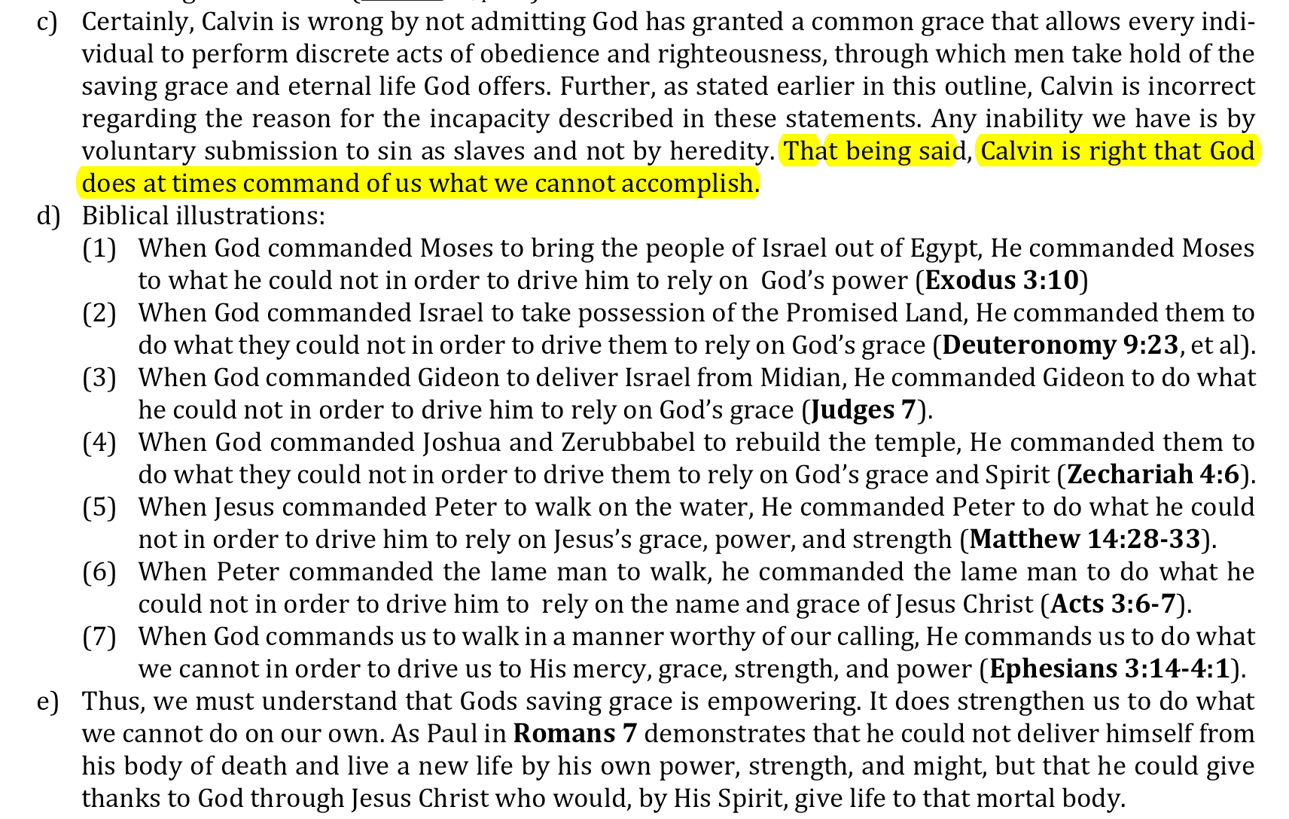

Slide 15
The Abused Text: Passages offered as proof
The Abused Text: Passages offered as proof
Romans 3:9-23
Romans 7-8
God commands what man cannot accomplish
  Argument is that God tells man to do things that man can’t do on his own
  These points only demonstrate man’s inability to save himself, not his inability to obey God
  There is nothing here to suggest that man cannot obey God without some empowering aid apart from the word of God!

Slide 16
The Abused Text: Passages offered as proof
The Abused Text: Passages offered as proof
Romans 3:9-23
Romans 7-8
God commands what man cannot accomplish
If we are slaves to sin - need
  Argument is that if one sins, he becomes a slave to sin (John 8:34) – thus he needs to be empowered to break free from the bonds
  Based on assumption – still assuming can’t obey
  Romans 6:16-17 – those who were slaves, obeyed to be free from sin
    Did that involve grace? Absolutely (Rom. 6:14)
    Nothing to indicate that man had to be “empowered” to obey

Slide 17
The Erroneous Concept: Man is unable to obey
The Abused Text: Passages offered as proof
The Assurance from God: Man has the ability to obey
The Erroneous Concept: Man is unable to obey
The Abused Text: Passages offered as proof
The Assurance from God: Man has the ability to obey
Man’s
Ability
to Obey
Notes:
Photo by Emmanuel Phaeton on Unsplash

Slide 18
The Assurance from God: Man has the ability to obey
The Assurance from God: Man has the ability to obey
Old Testament
  Gen. 4:6-7 – Cain was able to do well
  Heb. 11:8 – Abraham obeyed to call to go to a land
  Deut. 30:11-20 – Israel was told they could obey
    Not hard (vv. 11-14)
      Quoted in Rom. 10:6-8 applied to our salvation
      Thus, God’s commands in both OT and NT were within man’s ability
    Man has a choice (vv. 15-20)
  Joshua 24:15 – Joshua and Israel could choose to obey
  1 Chron. 28:8-10 – Solomon had a choice
  1 Kings 11:33-38 – Jeroboam had a choice

Slide 19
The Assurance from God: Man has the ability to obey
The Assurance from God: Man has the ability to obey
Old Testament
New Testament
  Matt. 7:21
  Heb. 5:8-9
  Rom. 10:20-21
  2 Thess. 1:7-9
  Gal. 3:1; 5:7
  Rom. 2:7-10
  2 Thess. 3:14
  1 Pet. 1:22

Slide 20
The Assurance from God: Man has the ability to obey
The Assurance from God: Man has the ability to obey
Old Testament
New Testament
If man does not have the ability to obey God
  God’s word is meaningless
  God’s word has no power at all
  God’s word produces no effect

Slide 21
The Assurance from God: Man has the ability to obey
The Assurance from God: Man has the ability to obey
Old Testament
New Testament
If man does not have the ability to obey God
Is there any example of God commanding us to do anything that we do not have the ability to do? If so, what is it?
Thus, we can obey God
No additional empowering aid is needed!

Slide 22
The Erroneous Concept: Man is unable to obey
The Abused Text: Passages offered as proof
The Assurance from God: Man has the ability to obey
The Erroneous Concept: Man is unable to obey
The Abused Text: Passages offered as proof
The Assurance from God: Man has the ability to obey
Man’s
Ability
to Obey
Notes:
Photo by Emmanuel Phaeton on Unsplash

Slide 23
The Nature of Sin (Nov. 10)
The Nature of Grace (Nov. 17)
Man’s Ability to Obey (Nov. 24)
Are We Under Law? (Dec. 1)
Faith and Works (Dec. 8)
How the Sinner is Forgiven (Dec. 15)
Imputed Righteousness (Dec. 22)
A Series
Notes:
Photo by Emmanuel Phaeton on Unsplash

