Slide 2
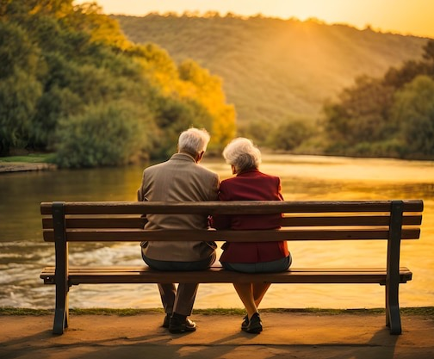
Not that I speak in regard to need, for I have learned in whatever state I am, to be content: I know how to be abased, and I know how to abound. Everywhere and in all things I have learned both to be full and to be hungry, both to abound and to suffer need.
Philippians 4:11-12
Contentment

Slide 3


Can’t deal with life’s changes!
Innate sense of entitlement!
Obsessed w/what’s wrong!
Compare self w/others!
Consumed with doubts!
Unceasing anxiety of future!
A need to be in control!
Craving latest, biggest, best!
Life is unfair for me!
Unwilling to let go of the past!

Slide 4

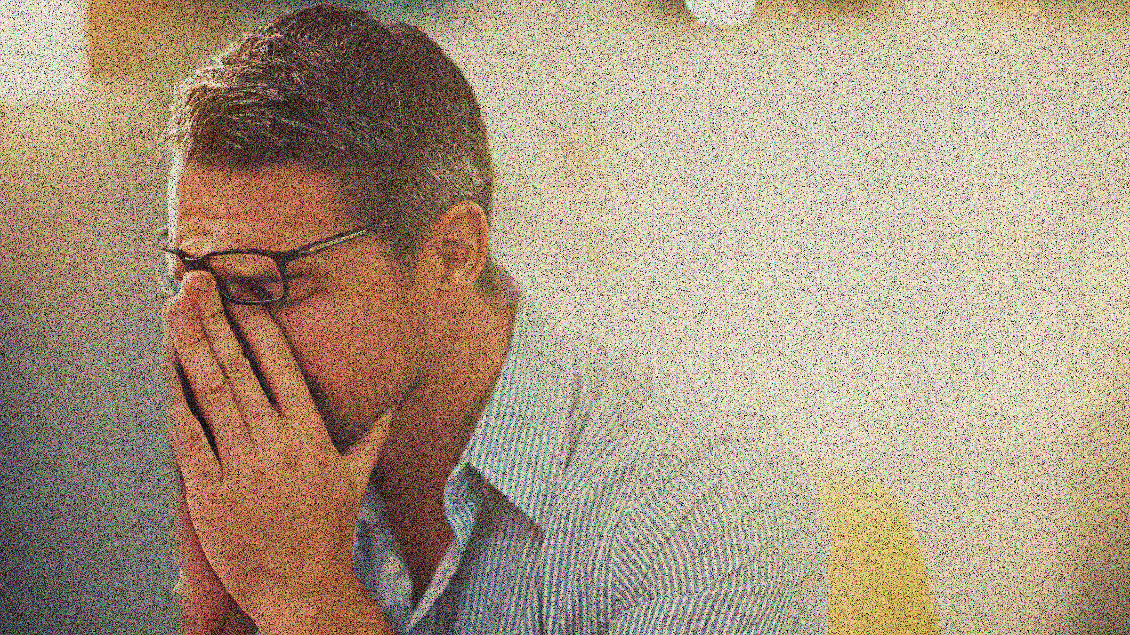
Read your Bible more (Eph 3:3-4; 2 Tim 2:15)
Increase your Faith (Matt 6:30; Mk 9:24)
Improve your Attendance (Heb 10:24-25)
Pray More & be Thankful (Phil 4:6)

Slide 5
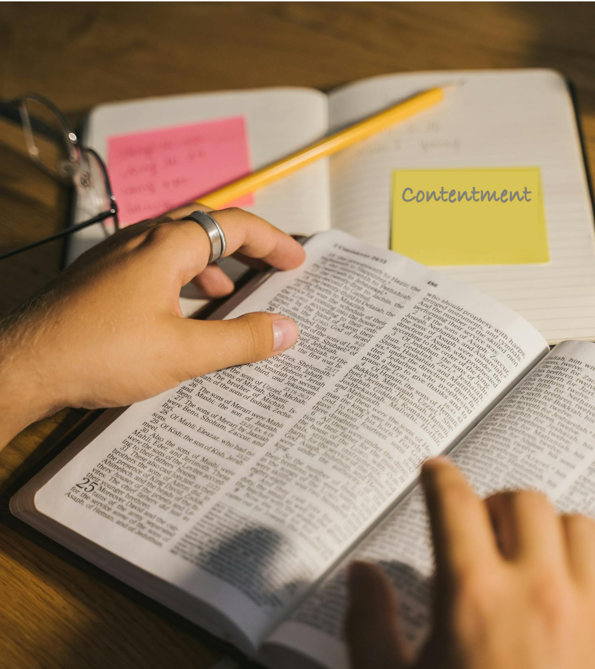

Phil 4:11-12 (autarkes), “Self-sufficient”
Heb 13:5 (arkeo), “Suffice,” “It is Enough”
Lk 3:14 (arkeo) wages are enough
Jn 14:7-8 (arkeo) enough to see the Father
1 Tim 6:7-8 (arkeo) food / clothing is enough
2 Cor 12:9 (arkeo) His grace is enough
Not that I speak in regard to need, for I have learned in whatever state I am, to be content: I know how to be abased, and I know how to abound. Everywhere and in all things I have learned both to be full and to be hungry, both to abound and to suffer need.
Phil 4:11-12
Let your conduct be without covetousness; be content with such things as you have. For He Himself has said, I will never leave you nor forsake you.
Heb 13:5
Likewise the soldiers asked him, saying, and what shall we do? So he said to them, do not intimidate anyone or accuse falsely, and be content with your wages.
Lk 3:14
If you had known Me, you would have known My Father also; and from now on you know Him and have seen Him. Philip said to Him, Lord, show us the Father, and it is sufficient for us.”
Jn 14:7-8
And He said to me, My grace is sufficient for you, for My strength is made perfect in weakness. Therefore most gladly I will rather boast in my infirmities, that the power of Christ may rest upon me.
2 Cor 12:9
For we brought nothing into this world, and it is certain we can carry nothing out. And having food and clothing, with these we shall be content.
1 Tim 6:7-8

Slide 6


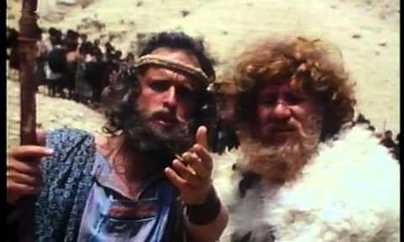
Then Esau said, what do you mean by all this company which I met? And he said, these are to find favor in the sight of my lord. But Esau said, I have enough, my brother; keep what you have for yourself.
Genesis 33:8-9

