Slide 1
The
Syro-Phoenician
Woman
Matt. 15:21-28
Mark 7:24-37

Slide 2
Matt 15:21-28
21 Then Jesus went out from there and departed to the region of Tyre and Sidon.
22 And behold, a woman of Canaan came from that region and cried out to Him, saying, “Have mercy on me, O Lord, Son of David! My daughter is severely demon-possessed.”
23 But He answered her not a word. And His disciples came and urged Him, saying, “Send her away, for she cries out after us.”
24 But He answered and said, “I was not sent except to the lost sheep of the house of Israel.”
25 Then she came and worshiped Him, saying, “Lord, help me!”

Slide 3
Matt 15:21-28
26 But He answered and said, “It is not good to take the children's bread and throw it to the little dogs.”
27 And she said, “Yes, Lord, yet even the little dogs eat the crumbs which fall from their masters' table.”
28 Then Jesus answered and said to her, “O woman, great is your faith! Let it be to you as you desire.” And her daughter was healed from that very hour.

Slide 4
Mark 7:24-30
24 From there He arose and went to the region of Tyre and Sidon. And He entered a house and wanted no one to know it, but He could not be hidden.
25 For a woman whose young daughter had an unclean spirit heard about Him, and she came and fell at His feet.
26 The woman was a Greek, a Syro-Phoenician by birth, and she kept asking Him to cast the demon out of her daughter.
27 But Jesus said to her, “Let the children be filled first, for it is not good to take the children's bread and throw it to the little dogs.”

Slide 5
Mark 7:24-30
28 And she answered and said to Him, “Yes, Lord, yet even the little dogs under the table eat from the children's crumbs.”
29 Then He said to her, “For this saying go your way; the demon has gone out of your daughter.”
30 And when she had come to her house, she found the demon gone out, and her daughter lying on the bed.

Slide 6
Matthew
The Work Which Thou Gavest Him to Do
Its Beginning or Inauguration (1:1 – 4:11)
Its Progress or Continuation (4:12 – 20:34)
  The Great Galilean Ministry (4:12 – 15:20)
  The Retirement plus Perean Ministries (15:21 – 20:34)
William Hendriksen, 621

Slide 7
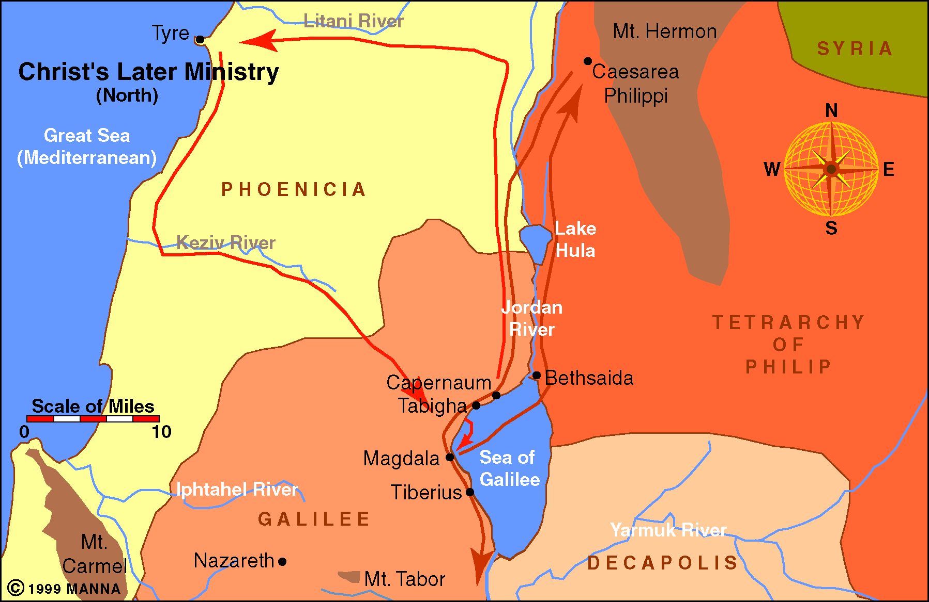

Slide 8
The
Syro-Phoenician
Woman
Woman Came to Jesus
Crying for Mercy,
Begging for Help
Matt. 15:21-28
Mark 7:24-37

Slide 9
The
Syro-Phoenician
Woman
The Reaction of Jesus
Seems Strange
Her Problems
Her Request
Her Obstacles
Her Faith
Were GREAT!

Slide 10
The
Syro-Phoenician
Woman
Her Character

Slide 11
Her Character
Woman of Canaan
  “Greek” (Mk. 7:26) – “a reference either to her religion, her language, or identity as a Gentile” (King)
  “So far as we know she was the first of Gentiles to obtain a blessing by faith in Jesus.” (Boles)
  Represents a class without promise, hope, God (Eph. 2:12)
  Learn:
    Such were we!
    Such are many “outcast” today who need mercy

Slide 12
Her Character
Woman of Canaan
Woman with Deep Anxiety
  Daughter is vexed with a devil (v. 22)
  Agony is seen “kept asking” (Mk. 7:26; cf. Mt. 15:22 –tense of “cried out” = again and again - Hendriksen)
  Utterly helpless
  Learn:
    No trouble that causes anxiety – like seeing your children under the influence of the Devil!
    “That crying thirst – drove her to the fountain!”
Notes:
Hendrickson 622

Slide 13
The
Syro-Phoenician
Woman
Her Character
Her Request

Slide 14
Her Request
Cry for Mercy
  Fell at his feet (Mk. 7:25) – sign of reverence and grief.
  Said: “Have mercy on me…” (v. 22)
  Mercy: “signifies, in general, ‘to feel sympathy with the misery of another,’ and especially sympathy manifested in act,…” (Vines)
  Learn:
    Cry for self is great – even greater when for your children!
    Prayer is short when mercy is first need!
    If mercy is first plea – will not be last!
    Cry for mercy – when recognize our helpless condition before God (cf. Matt. 5:3)

Slide 15
Her Request
Cry for Mercy
Cry to the Lord
  Recognized Jesus for who he was:
    “Lord” (v. 22) – Ruler, Master, Has power
    “Son of David” (v. 22) – Promised Messiah
    Only source for help – seen in continual asking
  Learn:
    Lord is the only source – help with sin, marriage, children, problems
    “The soul that bows as she did need say no more than ‘Lord, help me.’” (Boles)

Slide 16
The
Syro-Phoenician
Woman
Her Character
Her Request
Her Difficulties

Slide 17
Her Difficulties
Silence of Jesus (v. 23)
  Seems to be somewhat strange
  You would think – this is the kind of person he is seeking
  Seems to be ignoring her
  Why?
    Not told
    Seems to be a test of both her & his disciples
  Learn:
    When seems that God is ignoring – he may be drawing out more faith
    “Although He gives no word we may still hope in His character” (Handfuls on Purpose)

Slide 18
Her Difficulties
Silence of Jesus (v. 23)
Conduct of the Disciples (v. 23)
  Perhaps they misread His silence
  She, being a Gentile, viewed as a nuisance!
  How discouraging that must have been
  Learn:
    What we think will “help” the cause of the Lord – may not help at all
    Often, the conduct of some disciples will more likely drive people away

Slide 19
Her Difficulties
Silence of Jesus (v. 23)
Conduct of the Disciples (v. 23)
Her Own Unworthiness (v. 24)
  This too seems strange!
  Being a Gentile - did not belong to house of Israel
  Why this reaction?
    We are not told
    Seems to be to call forth her faith & teach his disciples
  Learn:
    Before we can receive mercy from God – we must realize our own unworthiness
    The most unworthy – need & can receive grace!

Slide 20
Her Difficulties
Silence of Jesus (v. 23)
Conduct of the Disciples (v. 23)
Her Own Unworthiness (v. 24)
Righteousness of God (v. 26)
  This seems even worse – “dog” was offensive and insulting
  Further testing of her faith – by putting her in the humblest of places
  Why take what belongs to Israel and give it to heathen?
  Learn: True faith is born out of humility!

Slide 21
The
Syro-Phoenician
Woman
Her Character
Her Request
Her Difficulties
Her Argument

Slide 22
Her Argument
Argument of Faith (vv. 27-28)
  Persistent and powerful plea (vv. 22, 27)
  Plea is based on faith – great faith (v. 28)!
  Great faith:
    Sees the problem – the evil
    Sees the cure – at the hand of the Lord
    Is humble
    Is earnest
    Persist when discouraged
  “Her faith takes her out as an exception to the whole Gentile world and holds her up as an example of faith to the Jewish race” (Boles).

Slide 23
Her Argument
Argument of Faith (vv. 27-28)
Argument of a Broken Spirit
  She humbly took her place of an undeserving dog!
  She had the broken & contrite spirit (Isa. 66:2; Psa. 51:17)
  “Grace delights to flow down and fill the needy” (Handfuls on Purpose)
  Learn: before we can ever expect the mercy of God – must have that contrite spirit!

Slide 24
The
Syro-Phoenician
Woman
Her Character
Her Request
Her Difficulties
Her Argument
Her Success

Slide 25
Her Success
Granted the Needed Blessing (v. 28)
  Her faith prevailed – praised for her faith
  Her need was granted fully!
  Her child was blessed as God blessed her (Mk)
  “Moreover, these blessings did not rob ‘children’ of their ‘bread’” (Hendricksen).
  Learn:
    Faith may be tested – but not disappointed
    Pressing on when discouraged – worth it!

Slide 26
Her Success
Granted the Needed Blessing (v. 28)
Embraced a Passing Opportunity (v. 22)
  She seized the only chance she had
  She made the most of it – while it was available
  Learn:
    Opportunities pass – then are gone
    Are you letting opportunities slip by?”

Slide 27
The
Syro-Phoenician
Woman
Her Character
Her Request
Her Difficulties
Her Argument
Her Success
Her Character
Her Request
Her Difficulties
Her Argument
Her Success

